Slide 1
Quizzes
You should remember these small code programming

Slide 2
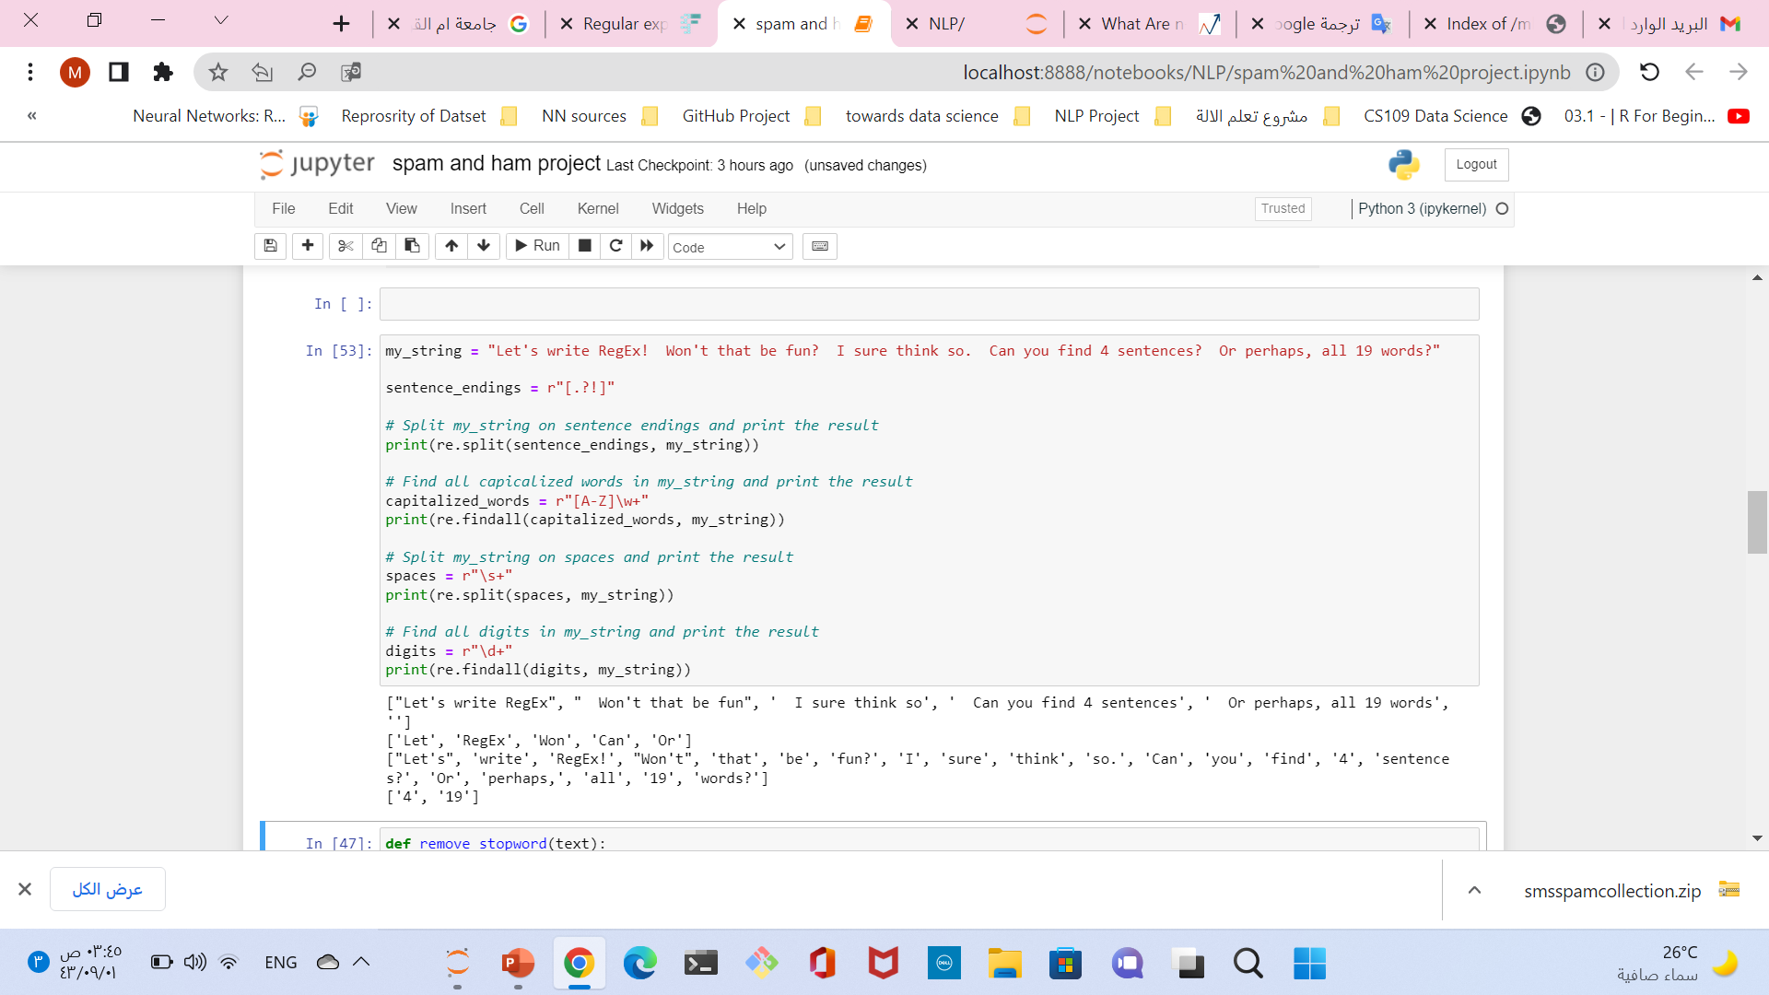

Slide 3
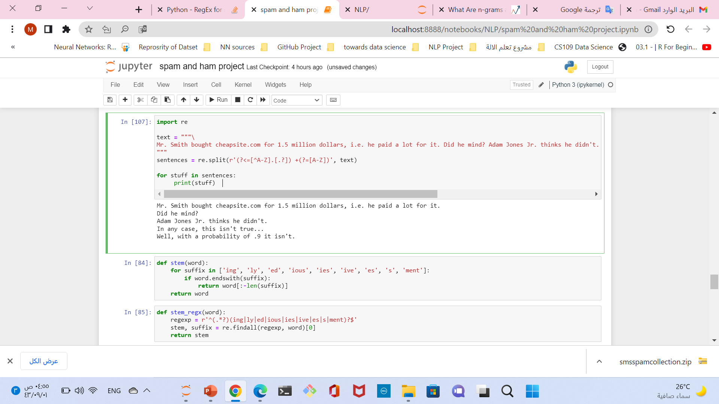
Tokenization in Python using RegEx and split

Slide 4
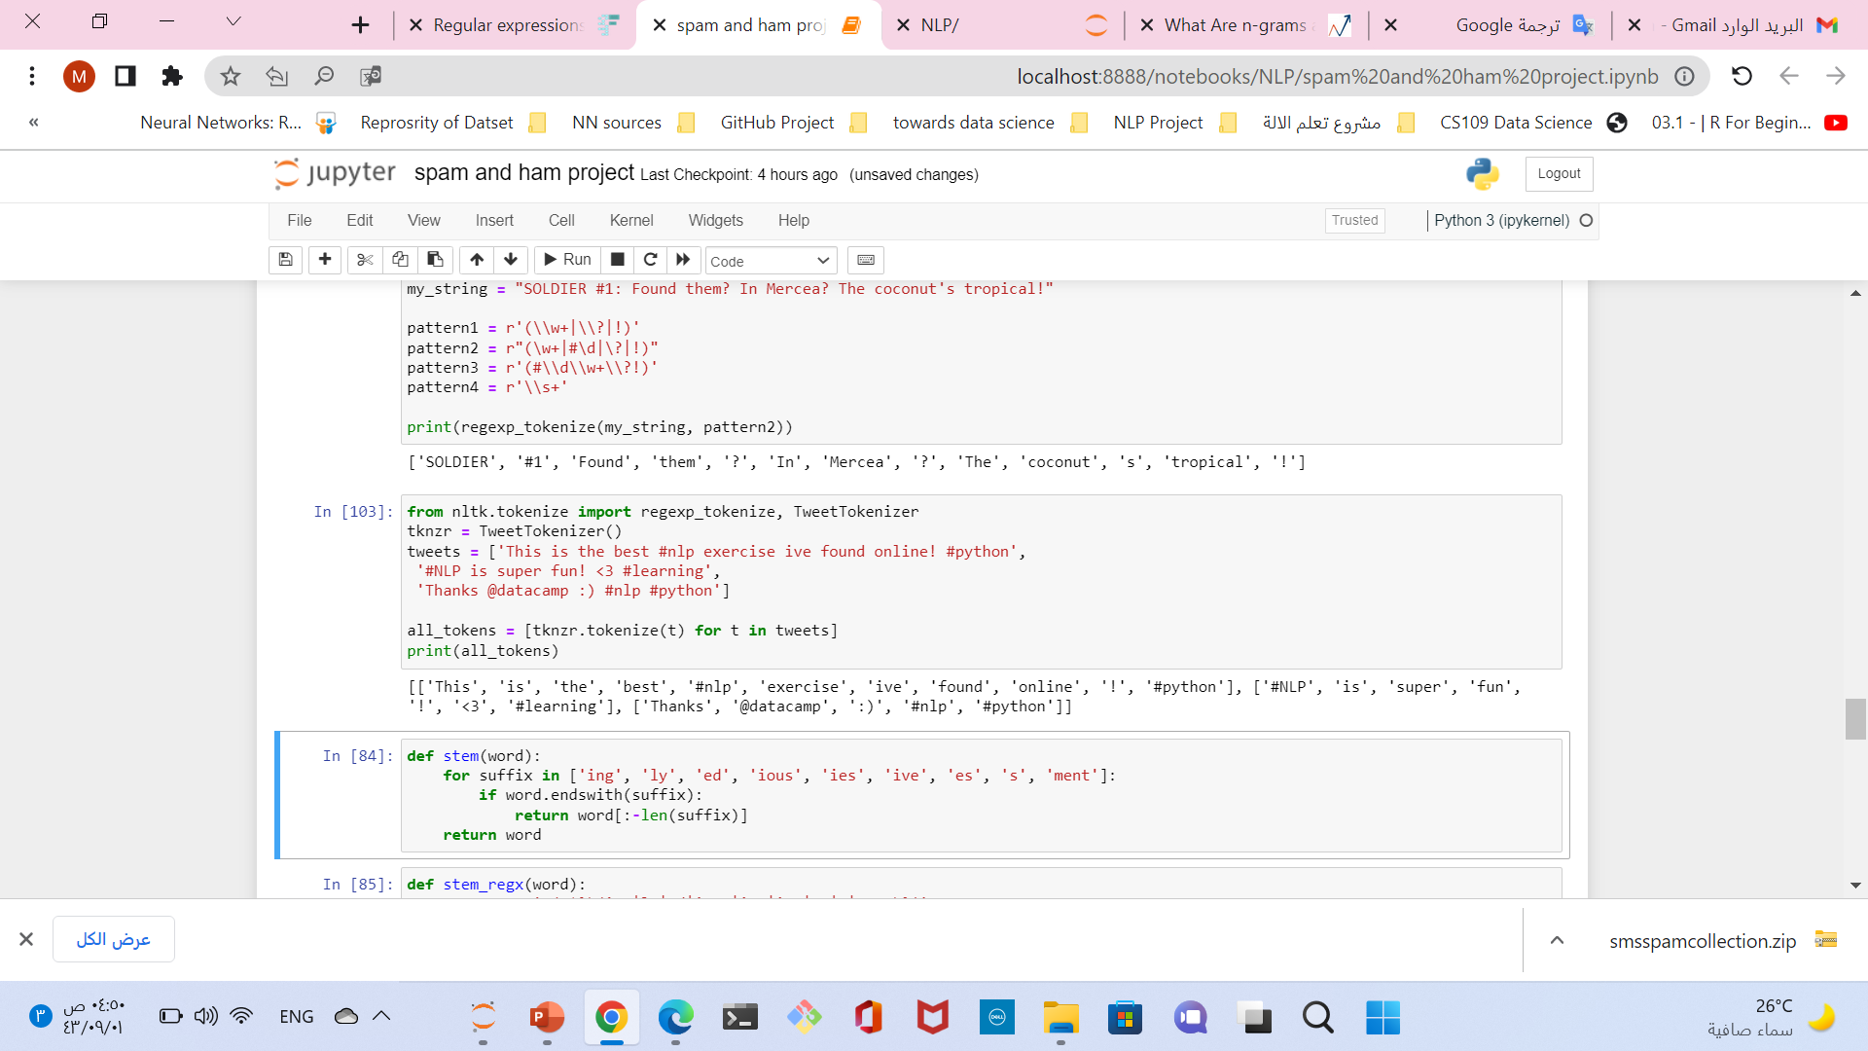
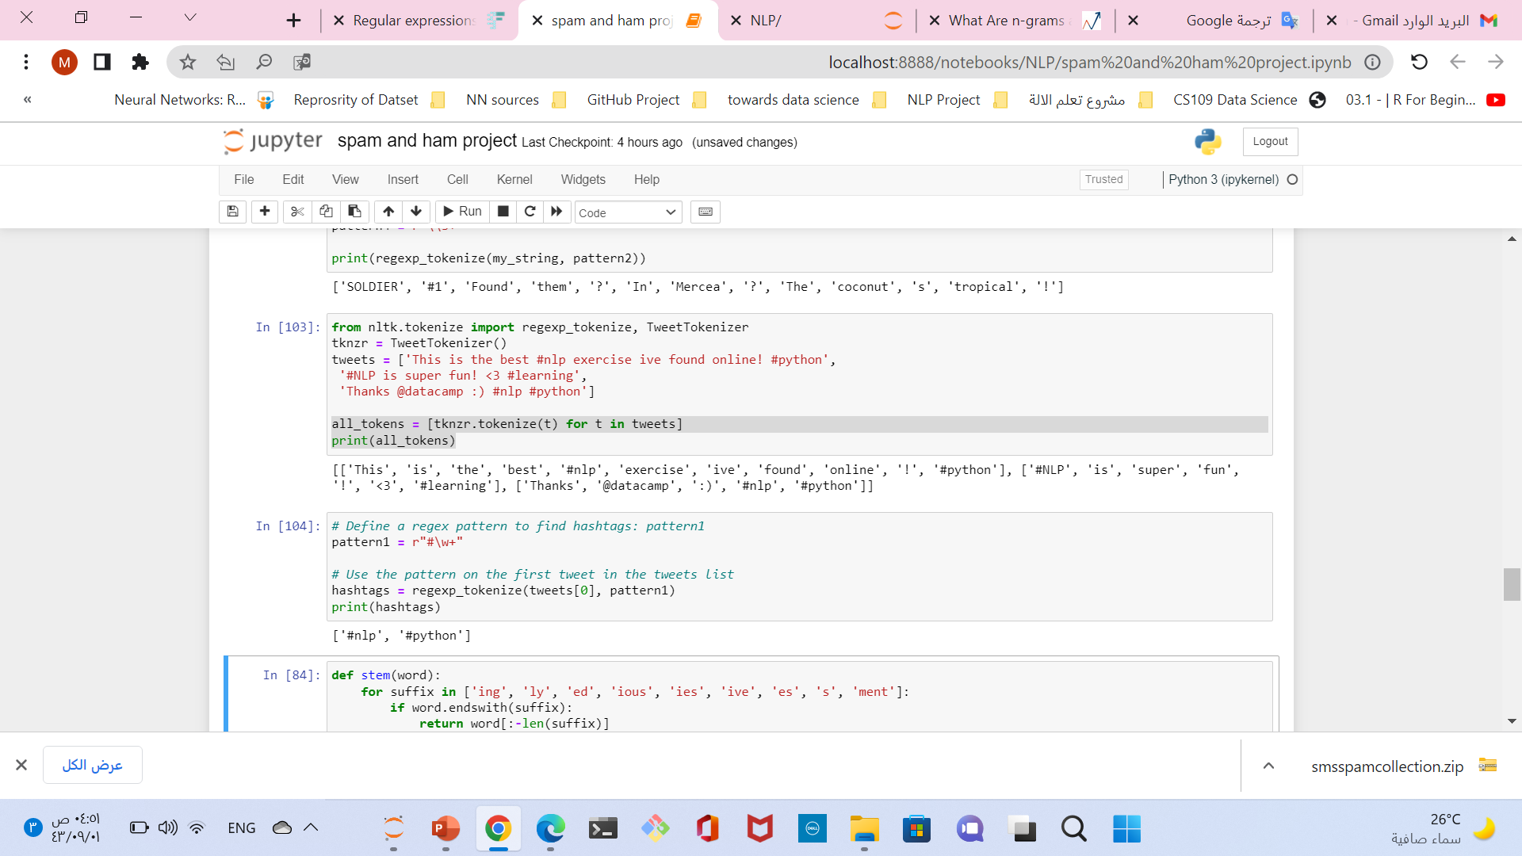
Regex with NLTK tokenization

Slide 5
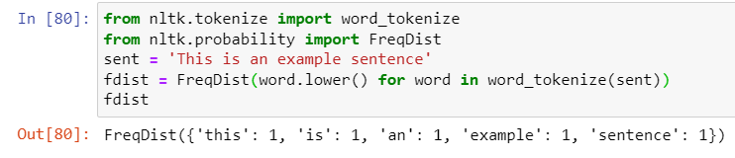
nltk.FreqDist()
frequency distribution: defined as a function mapping from each vocabulary to the number of times occurred in the text.
items(() -> list of D’s (key, value) pairs, ...)
keys(() -> list of D’s keys)
most_common([n])
List the n most common elements and their counts from the most common to the least.
values(() -> list of D’s values)

Slide 6
Quize:RGX write the RegularExpertion and drow it intoFSA
^(\(?\+?[0-9]*\)?)?[0-9_\- \(\)]*$
Matches | (+44)(0)20-12341234 | 02012341234 | +44 (0) 1234-1234
Non-Matches | (44+)020-12341234 | 12341234(+020)

Slide 7
Matches | (573)8841878 | 573-884-1234 | 573 234 1256
Non-Matches | (573)(673)2345 | 573-12-2345
^\(?[\d]{3}\)?[\s-]?[\d]{3}[\s-]?[\d]{4}$
^[2-9]\d{2}-\d{3}-\d{4}$
^\D?(\d{3})\D?\D?(\d{3})\D?(\d{4})$
Matches | 800-555-5555 | 333-444-5555 | 212-666-1234
Non-Matches | 000-000-0000 | 123-456-7890 | 2126661234
Matches | (111) 222-3333 | 1112223333 | 111-222-3333
Non-Matches | 11122223333 | 11112223333 | 11122233333
Matches | 1.2123644567 | 0-234.567/8912 | 1-(212)-123 4567
Non-Matches | 0-212364345 | 1212-364,4321 | 0212\345/6789
((\(\d{3}\)?)|(\d{3}))([\s-./]?)(\d{3})([\s-./]?)(\d{4})

Slide 8
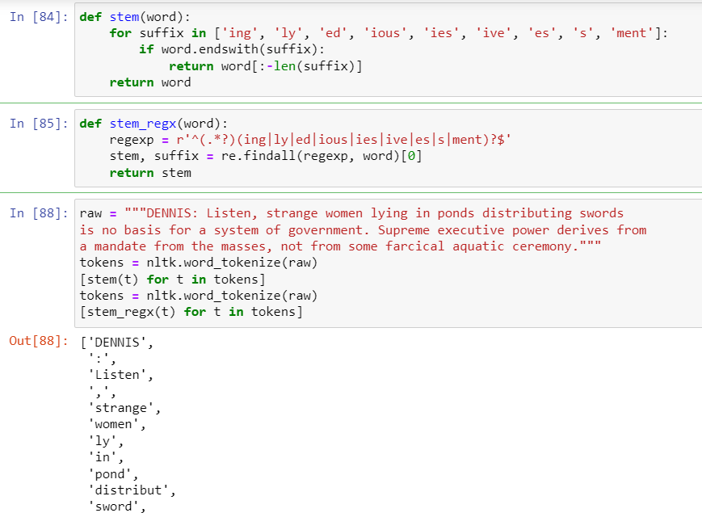
Finding Word Stems

Slide 9
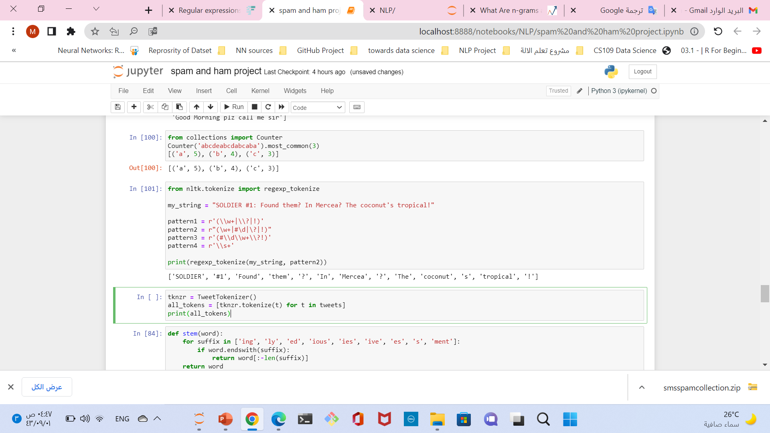
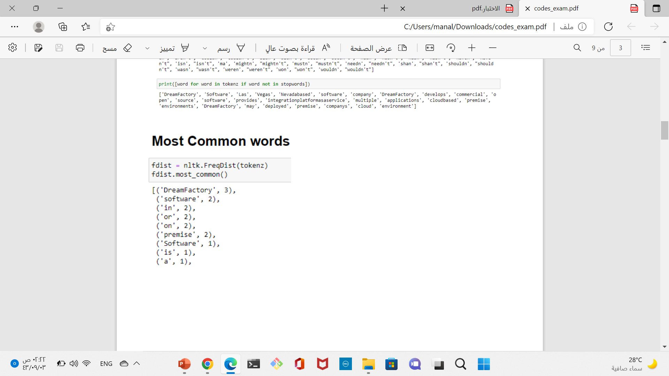
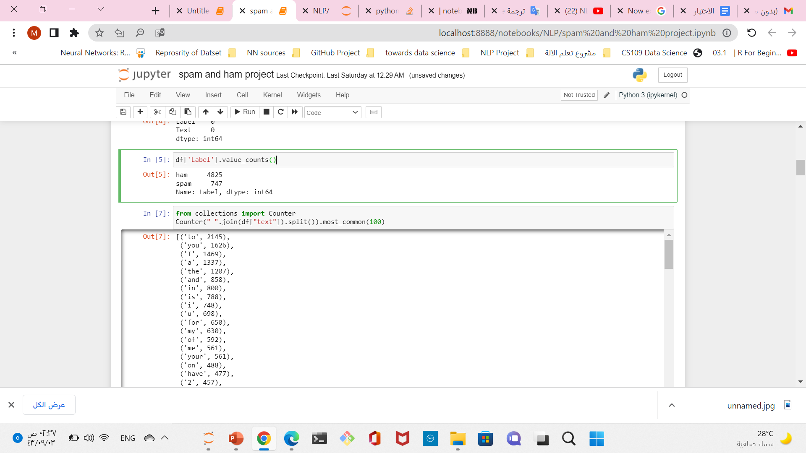
Quize: Most_common 50

Slide 10
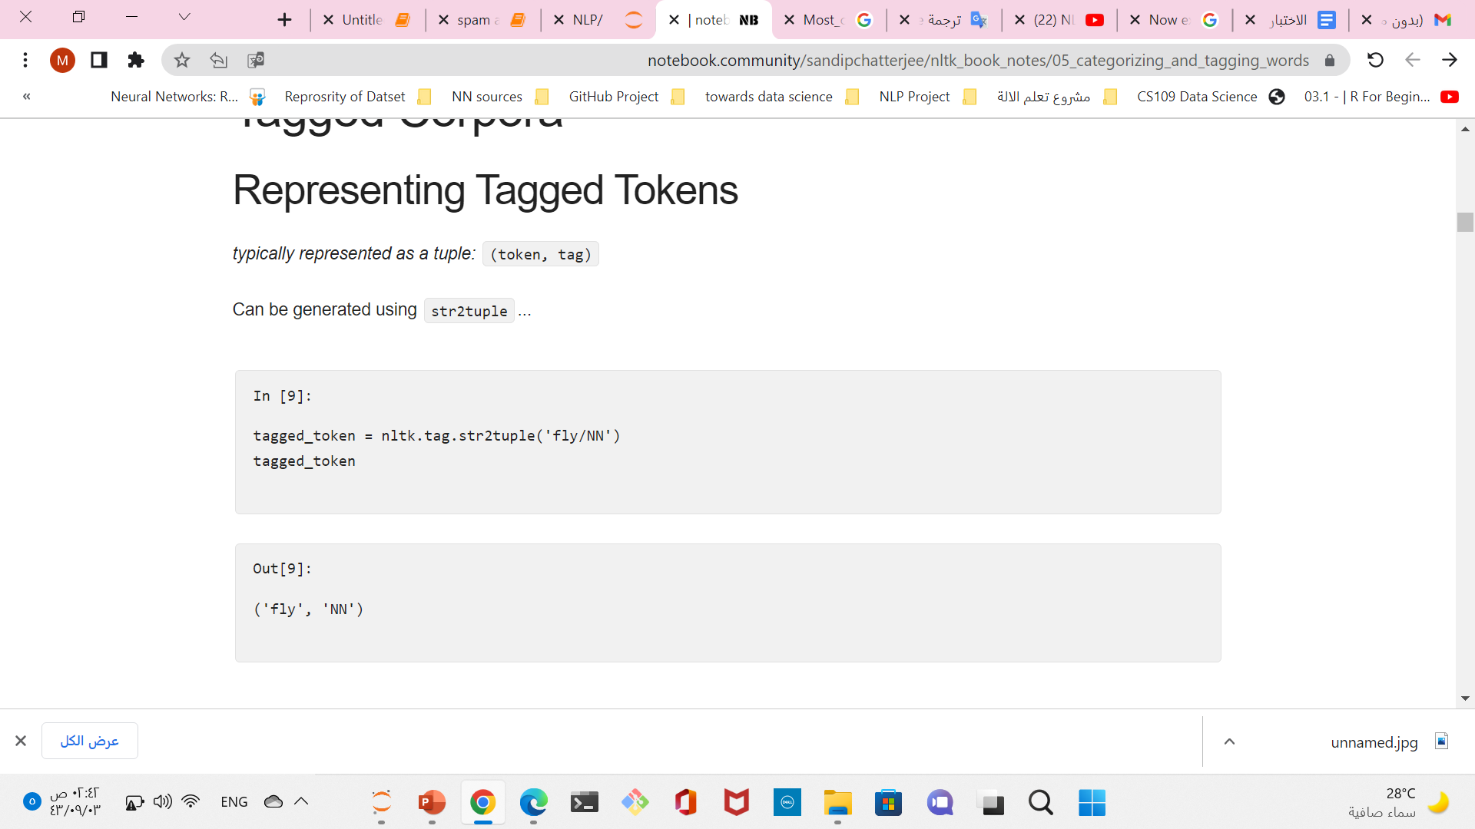
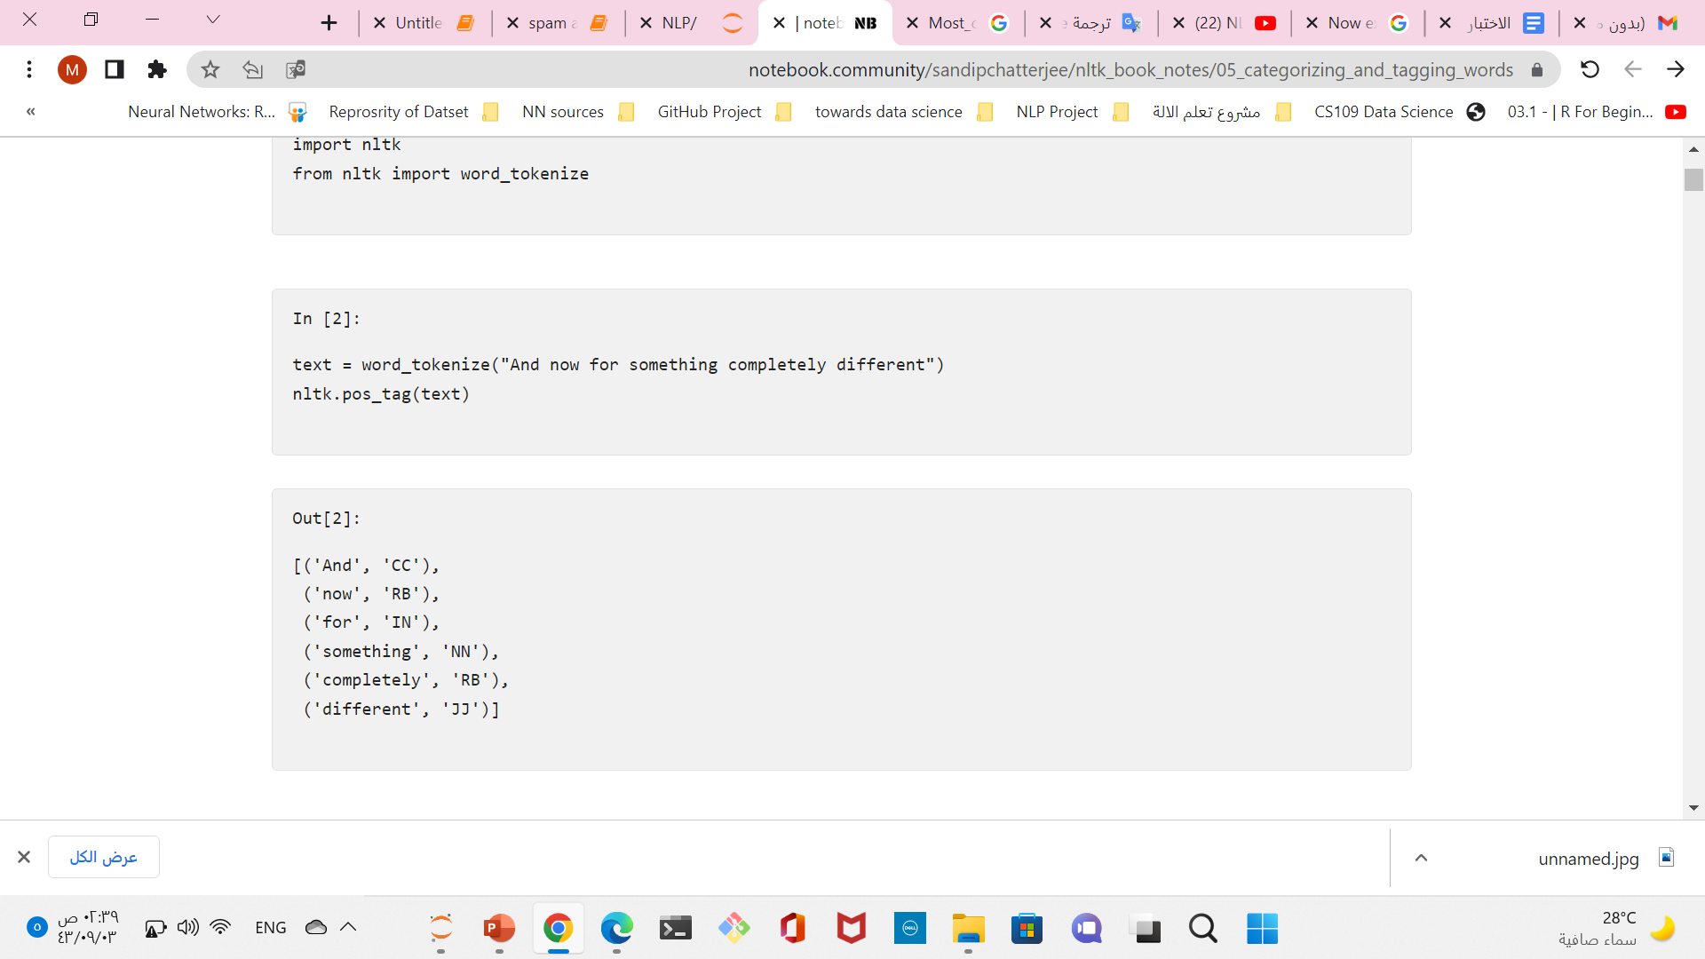
POS Quiz

Slide 11
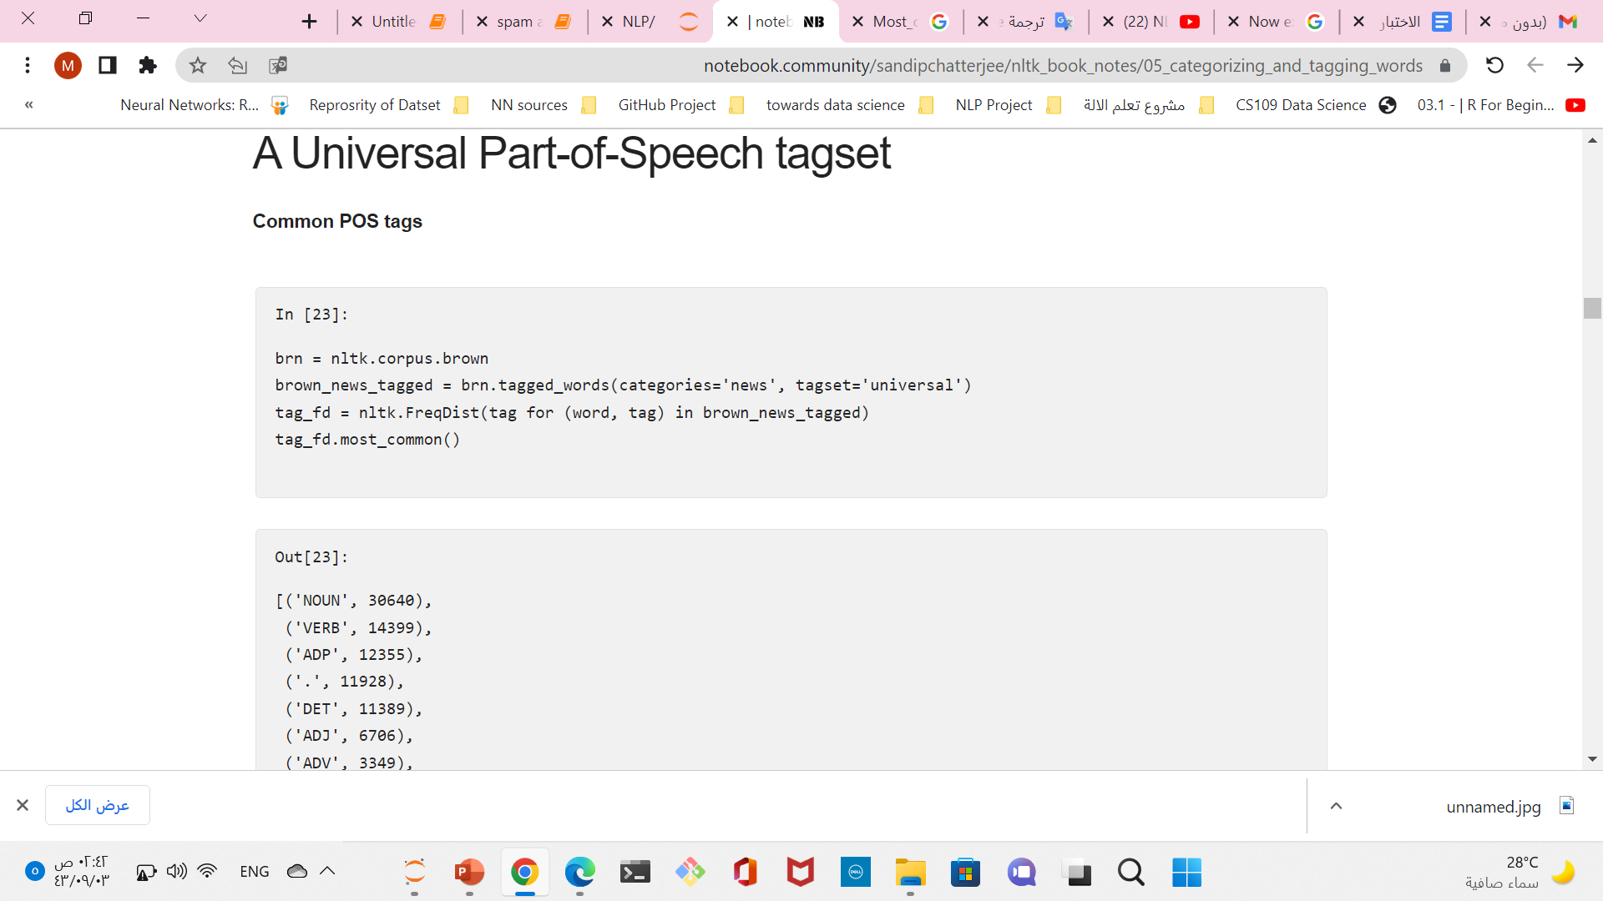
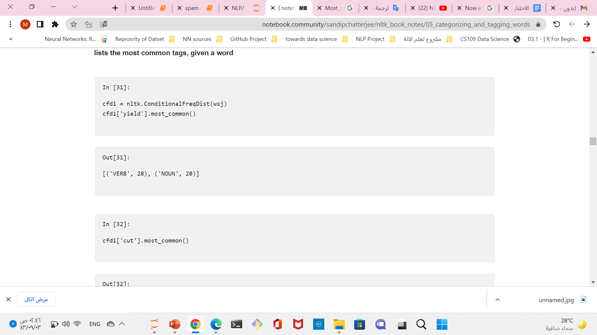

Slide 12
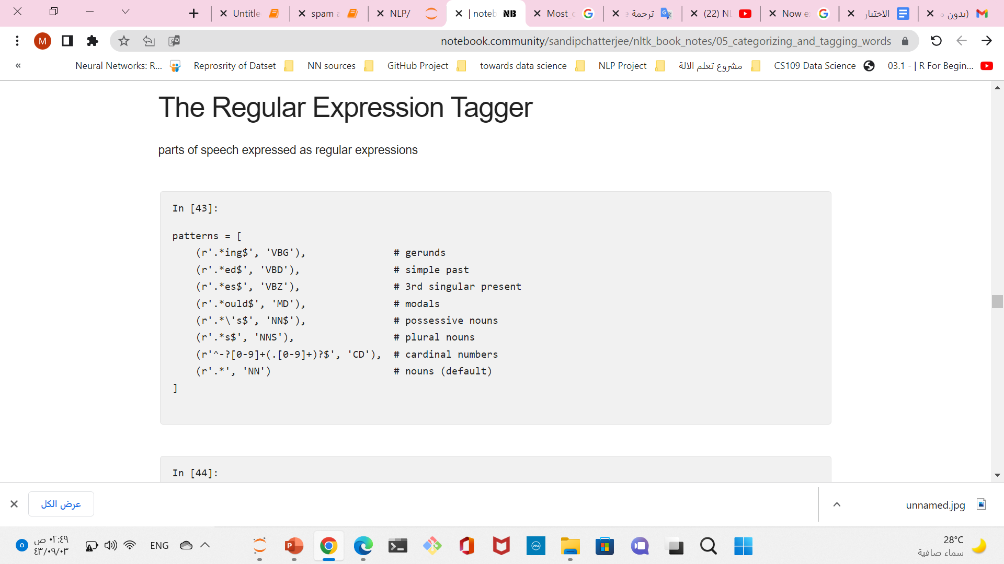
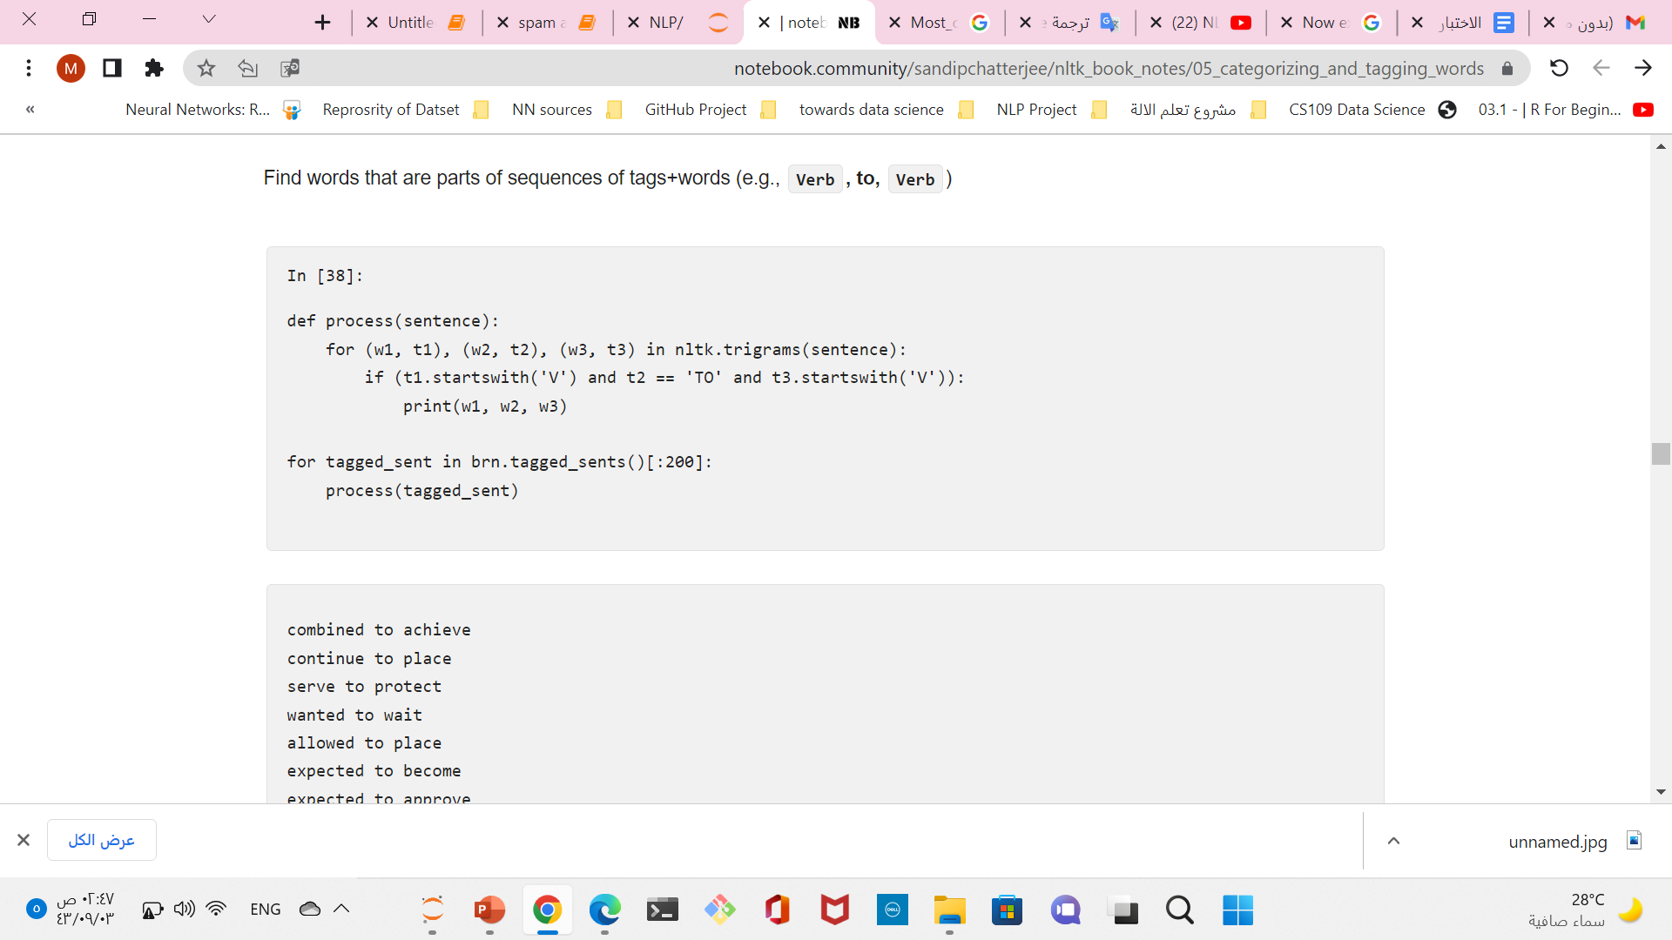
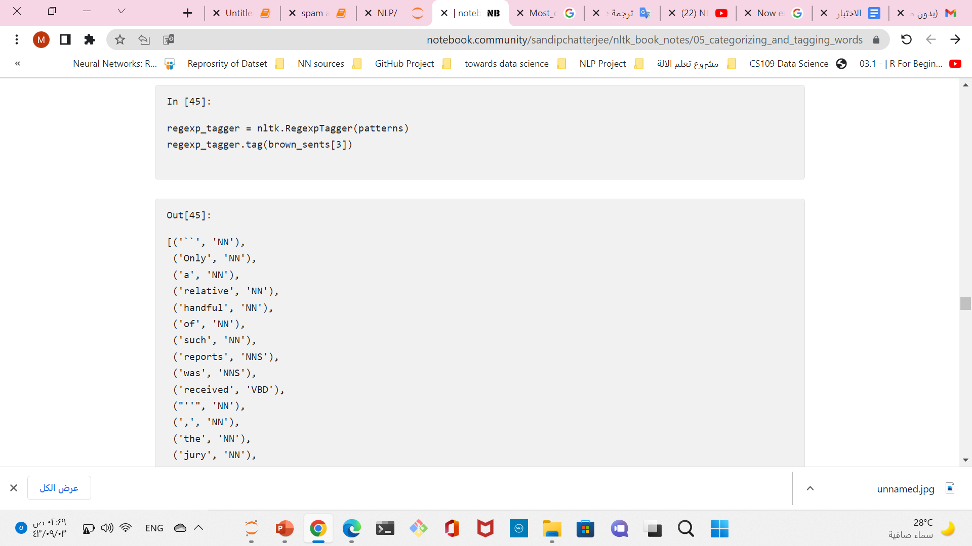

Slide 13
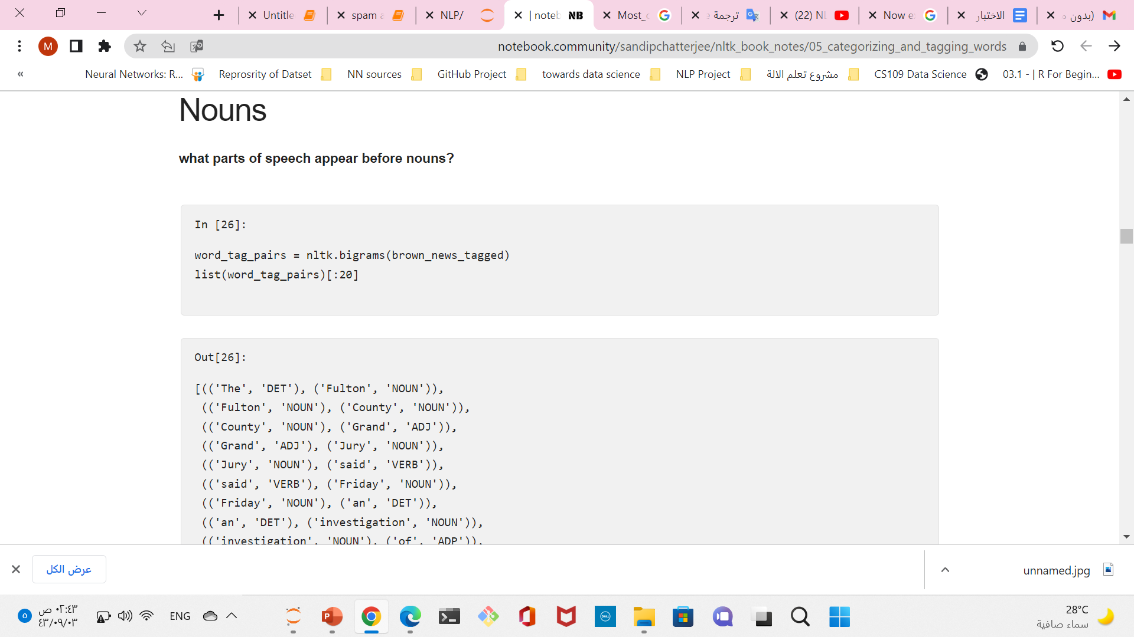
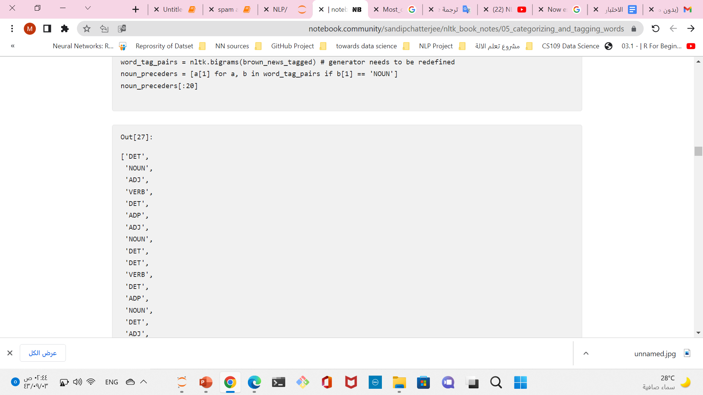

Slide 14
Quiz n-grams
from itertools import islice, tee
s = 'spam and eggs'
N = 3
trigrams = zip(*(islice(seq, index, None) for index, seq in enumerate(tee(s, N))))
list(trigrams)
# [('s', 'p', 'a'), ('p', 'a', 'm'), ('a', 'm', ' '),
# ('m', ' ', 'a'), (' ', 'a', 'n'), ('a', 'n', 'd'),
# ('n', 'd', ' '), ('d', ' ', 'e'), (' ', 'e', 'g'),
# ('e', 'g', 'g'), ('g', 'g', 's')]

Slide 15
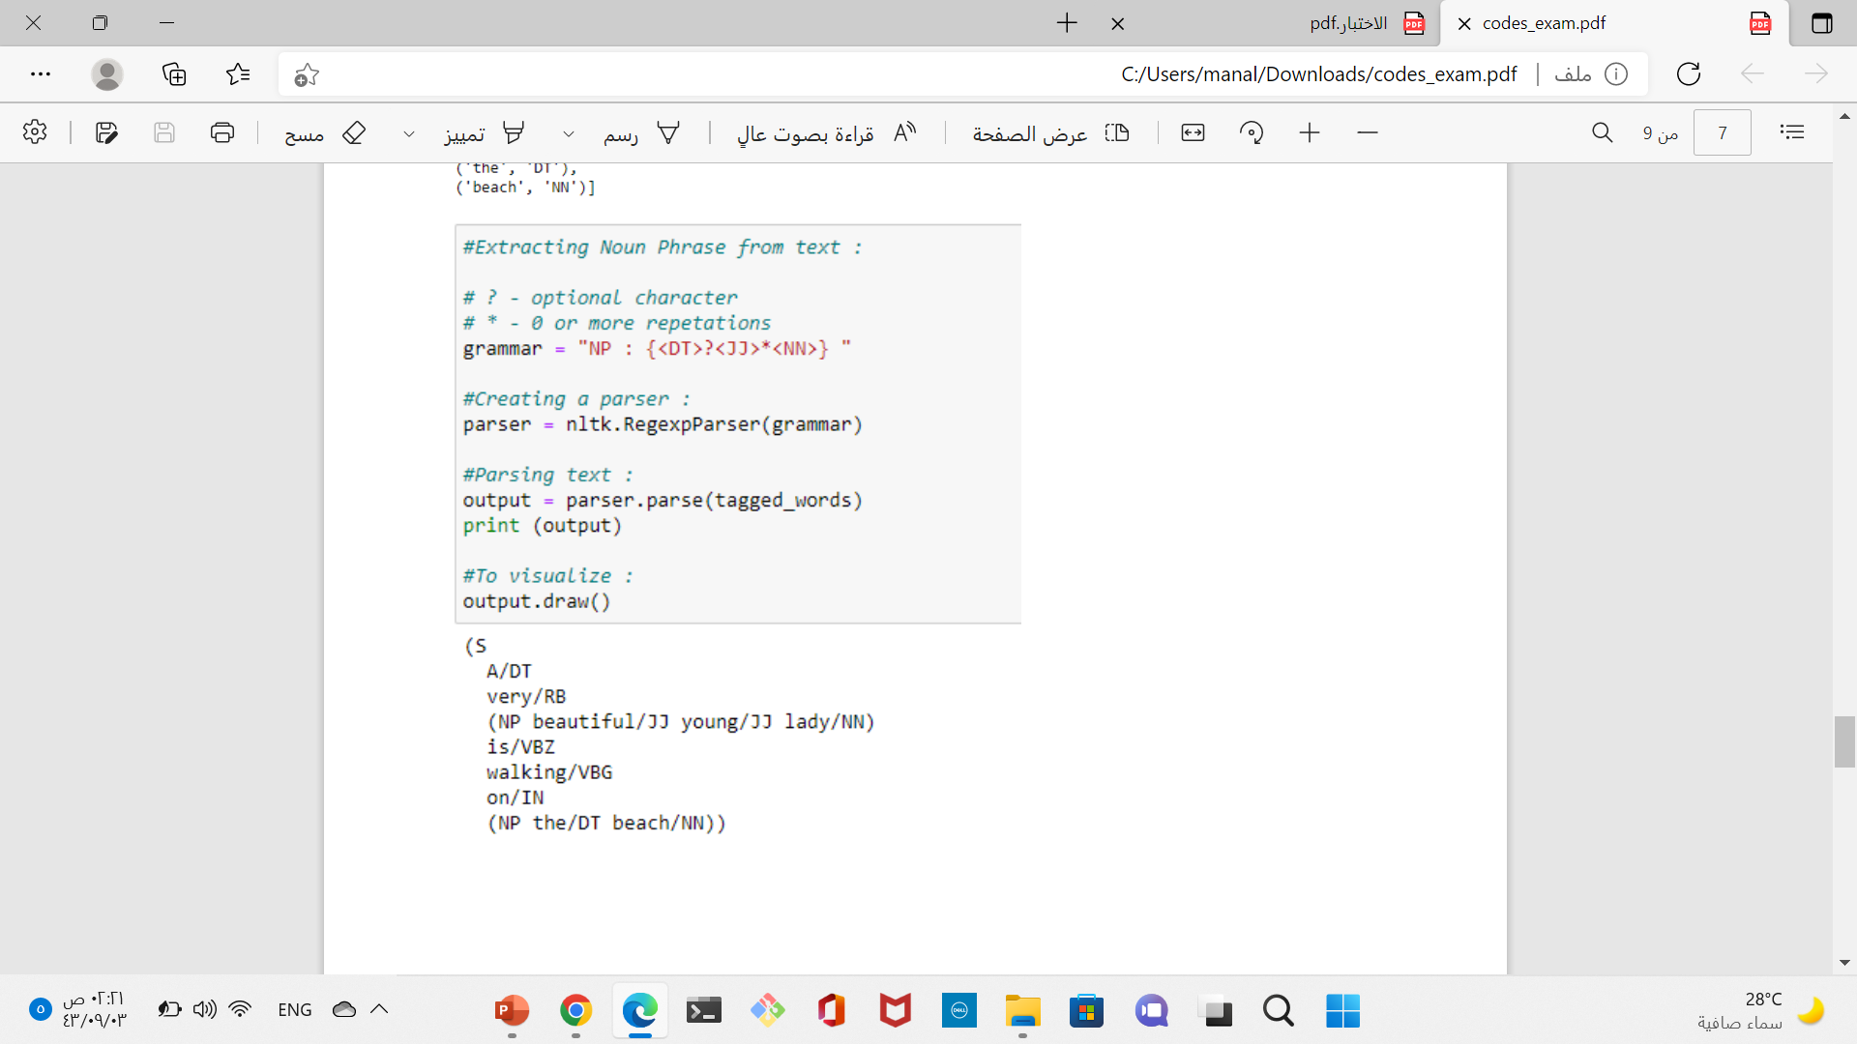
POS + PARSE Quiz
tokinaze=
tags=nltk.pos_tag(tokinze)
grammar=‘’ NP:{<DT>?<JJ>*<NN>}
parser=nltk.RegexpParser(grammar)
output= parser.parse(tags)
Print(output)
output.draw()

Slide 16
POS Quiz Find only words with specific type of POS”NNP”
sent ='spam and eggs'
tokenize =word_tokenize(sent)
al_sample_pos = pos_tag(tokenize)
for i in range(0 , len(al_sample_pos)):
if al_sample_pos[i][1] == 'NNP':
print(al_sample_pos[i][0])

Slide 17
POS Quiz Find only words with specific type of POS”NNP”
sent ='spam and eggs'
tokenize =word_tokenize(sent)
al_sample_pos = pos_tag(tokenize)
for i in range(0 , len(al_sample_pos)):
if al_sample_pos[i][1] == 'NNP':
print(al_sample_pos[i][0])

Slide 18
Consider a Part-of-Speech tagger1 producing the following output: The/Det program/N can/N deal/N with/Prep three/Num types/V of/Prep inputs/N
wsj = nltk.corpus.treebank.tagged_words(simplify_tags=True)
Wsj= nltk.pos_tag(tokinze)
word_tag_fd = nltk.FreqDist(wsj)
[word + "/" + tag for (word, tag) in word_tag_fd]

Slide 19
N-grams without using nltk
sentence = "I really like python, it's pretty awesome.".split()
N = 4
grams = [sentence[i:i+N] for i in xrange(len(sentence)-N+1)]
for gram in grams:
print (gram)
['I', 'really', 'like', 'python,']
['really', 'like', 'python,', "it's"]
['like', 'python,', "it's", 'pretty']
['python,', "it's", 'pretty', 'awesome.'

Slide 20
N-grams Using only nltk tools
from nltk.tokenize import word_tokenize
from nltk.util import ngrams
def get_ngrams(text, n ):
n_grams = ngrams(word_tokenize(text), n)
return [ ' '.join(grams) for grams in n_grams]
Example output
get_ngrams('This is the simplest text i could think of', 3 )
['This is the', 'is the simplest', 'the simplest text', 'simplest text i’,…………]

